Slide 1
Here We Stand
Ephesians 6:11-18

Slide 2
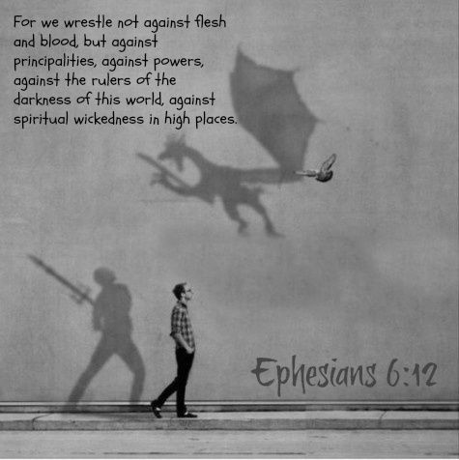
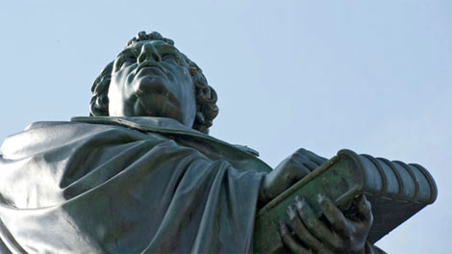
^{Ephesians 6:11-18 (ESV)}
¹¹ Put on the whole armor of God, that you may be able to stand against the schemes of the devil. ¹² For we do not wrestle against flesh and blood, but against the rulers, against the authorities, against the cosmic powers over this present darkness, against the spiritual forces of evil in the heavenly places. ¹³ Therefore take up the whole armor of God, that you may be able to withstand in the evil day, and having done all, to stand firm. ¹⁴ Stand therefore, having fastened on the belt of truth, and having put on the breastplate of righteousness, ¹⁵ and, as shoes for your feet, having put on the readiness given by the gospel of peace. ¹⁶ In all circumstances take up the shield of faith, with which you can extinguish all the flaming darts of the evil one; ¹⁷ and take the helmet of salvation, and the sword of the Spirit, which is the word of God, ¹⁸ praying at all times in the Spirit, with all prayer and supplication. To that end keep alert with all perseverance, making supplication for all the saints.

Slide 3
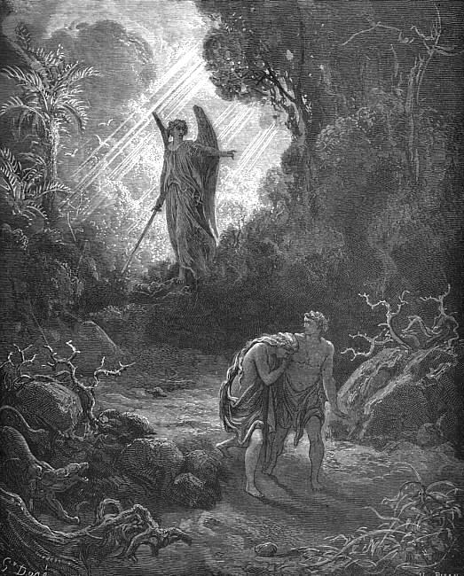
Where Are You?
God called to the man, “Where are you?”
they knew they were naked
same question echoes to us
universe around whispers it to us
our hearts wonder it
Equipping Lutherans to be Gospel-motivated voices For Life
Notes:
But the Lord God called to the man. He said to him, “Where are you?” [click] Before the aftertaste of forbidden fruit faded, the eyes of man and woman opened. [click] They knew they were naked, so they hid themselves, as if anything except six feet of solid earth could conceal them from the consequences. [click] This morning you and I have come from the very places Adam and Eve crouched down into. And the same question still echoes: “Where are you?” The Lord God calls to us, “Where are you?” [click] The universe around us whispers, with every sunrise and every rainfall, “Where’ve you been hiding?” [click] Our own hearts, in success or in regret, in both hopes and hurts, our heart wonder, “Where are you going?” Like a parent perking ears to the siblings’ sudden silence upstairs, “Where are you?” Like a cell phone ring tone an hour and a half after curfew, “Where are you?” [click]

Slide 4
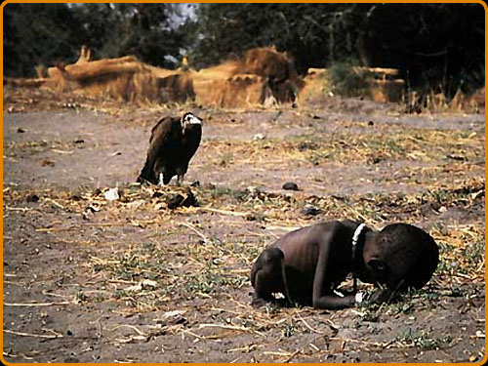
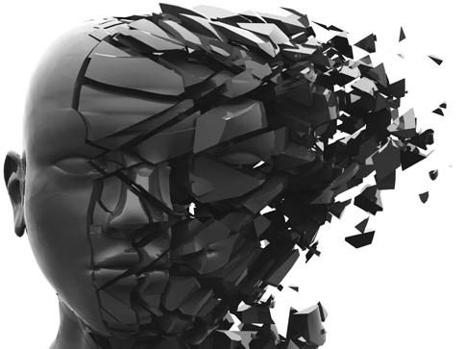
Where Are We?
hiding beside Adam’s and Eve’s skeletons
hunkering under scraps
struggling against spiritual forces of evil
fight and suffer, kill or be killed
unable to escape Almighty’s arm
Equipping Lutherans to be Gospel-motivated voices For Life
Notes:
We certainly ain’t in Eden anymore, Toto. The garden’s become a jungle. But we haven’t landed all that far from the first man and woman. [click] The Word of the Lord locates us squatting next to Adam-and-Eve’s skeletons. St. Paul the Apostle finds us right alongside the Ephesians – struggling. [click] Hiding behind whatever low-hanging brambles we can scrape up, and hunkering under any forest-floor scraps we can string together, we are all still struggling. [click] “For we do not wrestle against flesh and blood, but against the rulers, against the authorities, against the cosmic powers over this present darkness, against the spiritual forces of evil in the heavenly places” (Ephesians 6:12). [click] Our world occupies the intersection of man and monster, the epicenter of fight and suffer, kill or be killed. Our life inhabits the edges of death and hell itself, the gauntlet of sin and survival, live and let die. You can sit fences about politics. You may fall silent about controversies. But there remain rules, and fighting something with nothing fails nonetheless. [click] And no matter how far or fast you run you will not escape. You cannot slip beyond the reaches of the long arm of the Lord God Almighty. [click]

Slide 5
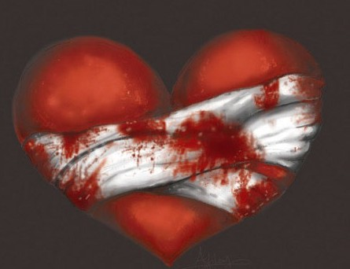
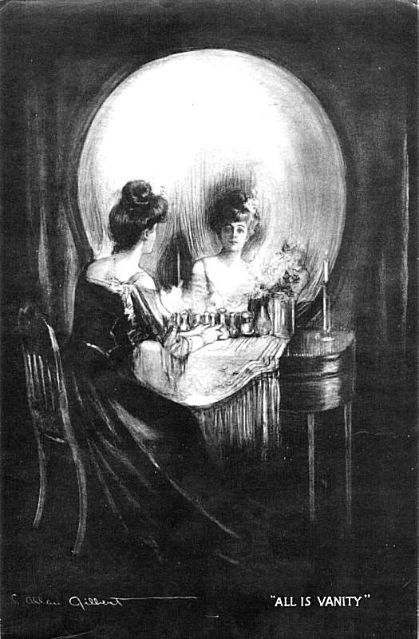
Where Are We?
mutilating bodies and imitating animals
grief and guilt lead to ending lives
terminating children, euthanizing parents
insist on human rights over heaven’s gifts
substitute autonomy for community
Equipping Lutherans to be Gospel-motivated voices For Life
Notes:
We have pains so sharp that we mutilate our bodies to match. [click] We bear needs so deep that we idolize animals and imitate their appetites. We wear eyes so hungry and mouths so angry that we squeeze the trigger and open fire before we’ve even seen the target as friend or foe. [click] We carry grief so heavy and guilt so haunting that we believe it freedom to end our own lives. [click] We haul fear so chilling and failure so choking that we tolerate terminating our sons and daughters and advocate euthanizing our mothers and fathers. We hold hearts so broken and divided that we accept lust rather than aspiring to love. We drag underbellies so vulnerable and blindsides so exposed that we separate children from marriage. [click] We lug spines so stiffened and skin so hardened that we settle for human rights instead of insisting on heaven’s gifts. [click] We host consciences so ruthless and demons so legion that we substitute autonomy for community. We tow priorities so demanding and plans so disappointing that they leave not even breathing room between us and any Ephesian arena or Middle Eastern battlefield. Here we stand. [click]

Slide 6
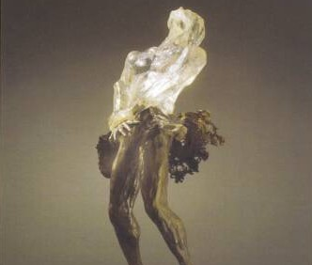
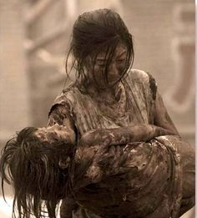
Who Are We?
in image of God we should know better
fallen souls and broken bodies
victims and culprits of violence against life
none independent, all impaired
require Savior and forgiveness
Equipping Lutherans to be Gospel-motivated voices For Life
Notes:
Yet where we are isn’t half as horrifying as who we are. Who we are makes it worse. [click] Lord God created this humankind of ours male and female in His own image. Father, Son, and Spirit made us each a little lower than the heavenly beings. We should know better. [click] But our flesh and blood lies fallen, and our bodies and spirits have been left broken. [click] We have become both victims and culprits of violence against life. We have grown compromised, conditioned by our cultures of death. We have gotten ourselves impaired, captive to sinful selfishness, whatever our state or shape or stage, from fertilization to final breath, heartbeat, and brainwave. [click] Nobody comes holier or worthier than the rest. No life proves more qualified or dignified. None of us stands isolated and independent of one another or harmlessly affecting only ourselves. We arrive, exist, and expire as neighbors by nature and brothers and sisters by birth whether we like it or not. [click] We all require armor, a Savior, deliverance, redemption. We all crave compassion, forgiveness, mercy, grace. Here we stand. [click]

Slide 7
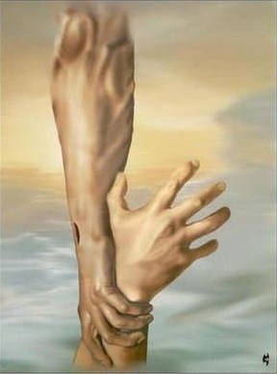
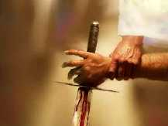
Why We Stand
never alone: Jesus is God’s armor for you
His eyes are helmet in pain and need
His breast is vest of forgiving peace
His arms are sleeve of faithfulness
His pierced hands are gloves of God’s passion
Equipping Lutherans to be Gospel-motivated voices For Life
Notes:
We do not stand alone. [click] We never stand alone. You do not get to stand alone, but you do not have to stand alone. Another One stands in your place. He has armor. He brings armor, and He gives armor, because He is armor. Jesus Christ is the armor of God, the whole armor of God, for you and for us all. He shelters, sustains, protects, and defends any who have not and cannot for ourselves. The Lord will fight for you, and you have only to be still. Fear not, stand firm, and behold the salvation the Lord works for you today. [click]
His etched brow arrays the confused one with a helmet of God’s paradise-opening incarnate presence that reaches her even in pain and need. His weeping eyes outfit the compromised person with a visor of God’s account-balancing obedient servanthood that touches her especially in hunger and anger. [click] The naked breast of Jesus clothes the conscience-laden spirit with a vest of God’s criminal-forgiving peace that takes him from his grief and guilt. [click] The outstretched arms of Jesus cover the unborn soul with a sleeve of God’s victim-favoring faithfulness that rescues us from fear and failure. [click] His pierced hands drape the elderly individual with a glove of God’s punishment-suffering passion that releases us from broken hearts and burning lusts. [click]

Slide 8
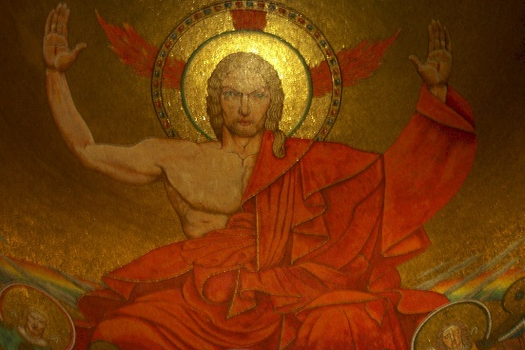
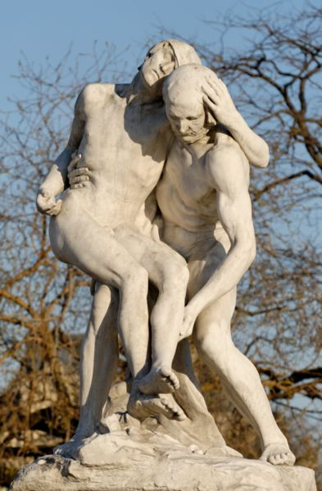
Why We Stand
His shoulders are shield of righteousness
His heart is jacket of resurrection
His torn flesh is mail of truth
His shed blood is justifying medicine
He stands here making humankind precious
Equipping Lutherans to be Gospel-motivated voices For Life
Notes:
The bare shoulders of Jesus [click] dress the impaired life with God’s wrath-satisfying righteous sacrifice like a shield that liberates us from our pride and priorities’ lies and from our lacking plans and capacities. [click] His punctured heart wraps the raw being with God’s wrongs-redeeming resurrection power like a jacket that frees you from keeping score. His bruised heels equip those who are abandoned with God’s debt-settling salvation like boots that spare you from using each other and proving yourselves. [click] The torn flesh of Jesus endows any who are bedeviled with God’s unconditionally-accepting truth like chainmail that embraces them also out of their sin and death. [click] His shed blood arms all who are vulnerable with God’s life-justifying Word like medicine that cradles them away from the Devil and hell. [click] Because Jesus stands here, here we stand, every human being precious at every stage in every state, no matter what she’s done, no matter what he can’t do. Jesus is why we stand, and we stand in Christ with the many blessings of abundant and everlasting life. [click]

Slide 9
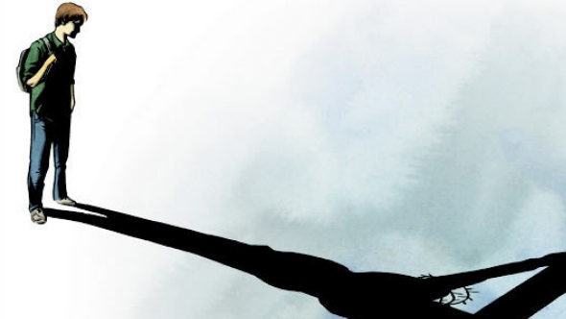
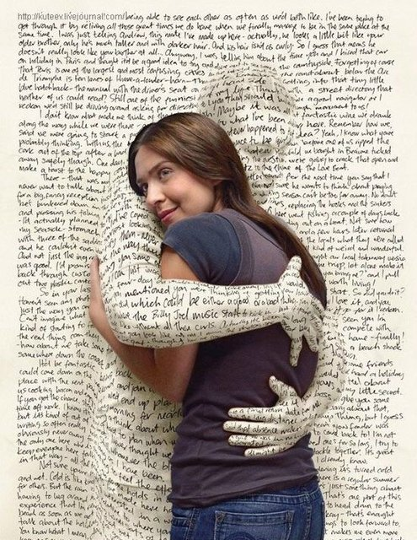
Where We Stand
upon the promises of God’s Word
with each other in the Church’s fellowship
claimed in Baptism, preserved in Communion
grace, not works; faith, not feelings
beside Jesus and behind God
Equipping Lutherans to be Gospel-motivated voices For Life
Notes:
We see where we stand because He shows us. We face who we are because He declares it. We know why we stand because He shares it. And now we know how we’re here because He demonstrates that as well. [click] We stand upon the promises of God’s own very Word and not under popular opinion or conventional wisdom. [click] We stand with you because of the Church’s ministry and brotherhood and not by the culture’s impulses or bandwagons. [click] You stand claimed and positioned in this Baptismal Sacrament, crowned and preserved through this Holy Communion. [click] You stand with us among grace rather than atop works, amid faith instead of about feelings. [click] Here we stand, five centuries on, two millennia after, and since creation until second coming, between the multitudes of faithful Christians across time and millions of forgiven children around the world, beside Christ Jesus our Savior and behind God as Father. [click]

Slide 10
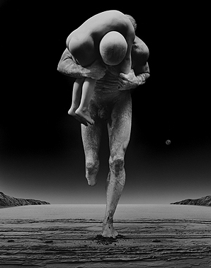
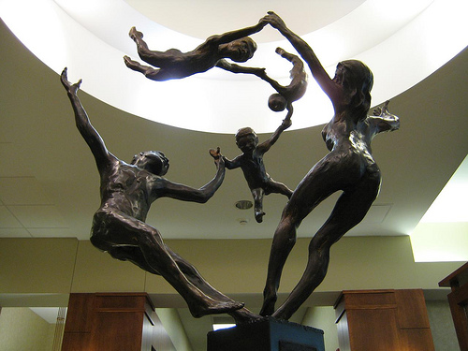
How We Stand
in joy and hope, not fear and anger
for forgiving and saving, not competing
to relieve and befriend, not accuse or attack
speaking truth and sharing love
Gospel-motivated Lutheran voices For Life
Equipping Lutherans to be Gospel-motivated voices For Life
Notes:
Here we stand, neither stampeding nor strutting. [click] Here we stand in joy and not out of anger, in hope and not out of fear, [click] because we stand to forgive and not compare, to save and not compete. [click] Here we stand to relieve and release, not to accuse, because stand to listen, assist, accompany, embrace, and befriend, not to attack. [click] Here we stand speaking truth and sharing love, because we stand overcoming sin and selfishness, death and the Devil, and not against one another. Here we stand firm but gentle, strong but humble, even after so long and before such odds. [click] Here we stand, Gospel-motivated voices, Lutherans For Life, because we can do no other, God help us. Amen. [click-end]

