Slide 1
1 Peter 3:15-22
Life Sunday 2018
Equipping Lutherans to be Gospel-motivated voices For Life

Slide 2
1 Peter 3:15-22 (ESV)
¹⁵In your hearts honor Christ the Lord as holy, always being prepared to make a defense to anyone who asks you for a reason for the hope that is in you; yet do it with gentleness and respect, ¹⁶having a good conscience, so that, when you are slandered, those who revile your good behavior in Christ may be put to shame. ¹⁷For it is better to suffer for doing good, if that should be God’s will, than for doing evil.
¹⁸For Christ also suffered once for sins, the righteous for the unrighteous, that he might bring us to God, being put to death in the flesh but made alive in the spirit, ¹⁹in which he went and proclaimed to the spirits in prison, ²⁰because they formerly did not obey, when God’s patience waited in the days of Noah, while the ark was being prepared, in which a few, that is, eight persons, were brought safely through water. ²¹Baptism, which corresponds to this, now saves you, not as a removal of dirt from the body but as an appeal to God for a good conscience, through the resurrection of Jesus Christ, ²²who has gone into heaven and is at the right hand of God, with angels, authorities, and powers having been subjected to him.
Equipping Lutherans to be Gospel-motivated voices For Life

Slide 3
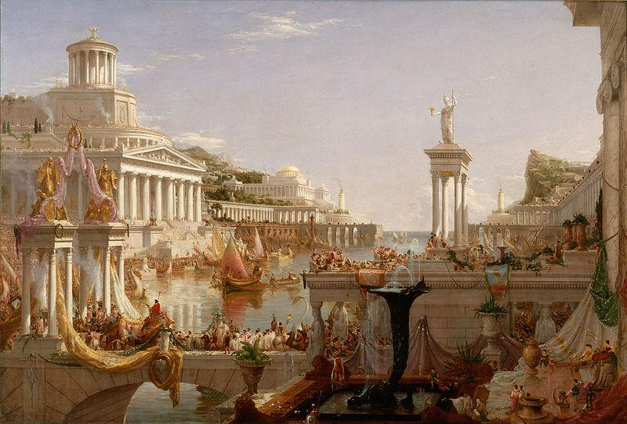
Who’s Asking About Hope?
Peter’s background is Pax Romana
two centuries of military tranquility
political unity & economic stability
technological innovation & philosophical insight
carpe diem!
Lutherans For Life
1 Peter 3:15-22
Life Sunday 2018
Notes:
Who’s asking about hope? Who’s gonna ask about our hope? And why would they have to ask us, Mister Peter? [click] Wake up and smell the progress! I mean, welcome to the Roman Empire! You’re writing during the good old days, the golden age, classical antiquity, the height of human civilization. We’re living in the Pax Romana, an awesomeness beyond the best years Egypt, Assyria, Babylon, Persia, or Greece ever saw. [click] We’re talking two solid centuries of military tranquility. [click] Look at our political unity and economic stability. [click] Check out our technological innovation and philosophical insight. They compose tomes and poems about these times. They paint masterpieces and put up monuments to our society. They name half the calendar after our era. Our cultural achievements will epitomize the western world for millennia to come, often imitated but never duplicated. [click] Hope? We don’t need those stinkin’ pledges! We’ve got tonight; who needs tomorrow? Carpe diem! [click]

Slide 4
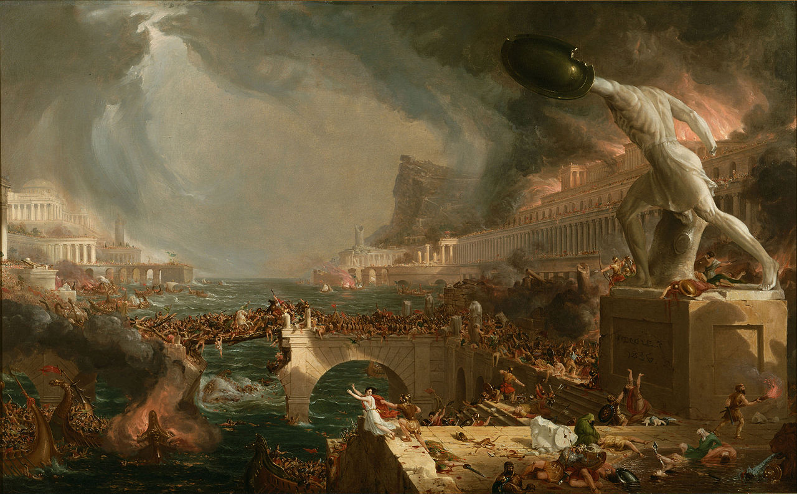
How’s It Working Out?
women are property & slaves are animals
superstitions & sacrifices
promiscuity & perversion
corruption & discrimination
famines & infections, long days & short lives
Lutherans For Life
1 Peter 3:15-22
Life Sunday 2018
Notes:
What’s that? How’s it working out? You mean how’s that working out for us? [click] Well, we consider women property. And we treat slaves like animals. [click] Popular superstitions involve sacrifice, sometimes even children. [click] We do encourage rampant promiscuity, approve ritual prostitution, engage in rank perversion. [click] Of course, bribes buy government corruption and judicial discrimination. We expect and accept rampant fraud in commerce. Yes, we ignore or oppress the poor and persecute minorities. We do discard the elderly, exile the disabled, abort or abandon babies. [click] Floods and famines devastate. Epidemic infections decimate. Days run long and cut lives short. What were you saying about hope again? Y’all got any more of that left? [click]

Slide 5
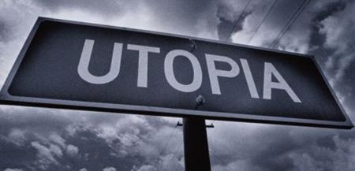
New & Improved Formula?
capture & manufacture satisfaction
extended life & increased leisure
equity in self-expression
mastered earth & entered outer space
cooperation & tolerance (not uniqueness)
Lutherans For Life
1 Peter 3:15-22
Life Sunday 2018
Notes:
Here, try the twenty-first century formula. We’ve trademarked new, improved humankind. We discovered what previous peoples lacked. We’ve become enlightened after two thousand years’ experience. [click] We can capture and manufacture exactly the satisfaction you seek. [click] Our medical advances have extended life expectancy. Our automated mechanisms have lowered costs and increased leisure. [click] Our agricultural revolutions have procured surplus resources and secured equitable property distribution. [click] We’re establishing representative government the world over while exploring and inhabiting outer space. We’re enshrining in global law justice and choice for education and employment, self-expression and sexuality. We’ve domesticated earth’s raw materials and tamed nature’s ways while preserving the planet’s diverse environments and equally valid civilizations. [click] We’ve swapped conquering for cooperation because we see the not-uniqueness of human beings. [click]

Slide 6
Who Needs Christian Hope?
Obsolete & unsuccessful
Arrogant & annoying
Inconsistent & dishonest
Delusional & persecuted
Ludicrous doctrines & silly little rituals
Lutherans For Life
1 Peter 3:15-22
Life Sunday 2018
Notes:
Who needs hope anymore? Who’d ask Christians about hope anyway, Mister Preacher? [click] We long since showed them to be obsolete, irrelevant, unsuccessful, and pathetic. We find them ignorant, gullible, unrealistic, and plain lazy. [click] They’ve proved themselves intolerant, arrogant, annoying, and just mean. [click] They’ve revealed how inconsistent, hypocritical, dishonest, and downright debunked they can get. [click] Christians get themselves ridiculed, evicted, imprisoned, tortured, and murdered clinging to their legends and their delusions and their traditions. [click] Their kind of hope, with its ludicrous doctrines and silly little rituals, leaves them loners, losers, fundamentalists, and fanatics with a fetish for fabrications, from Peter’s Epistle to the present. [click]

Slide 7
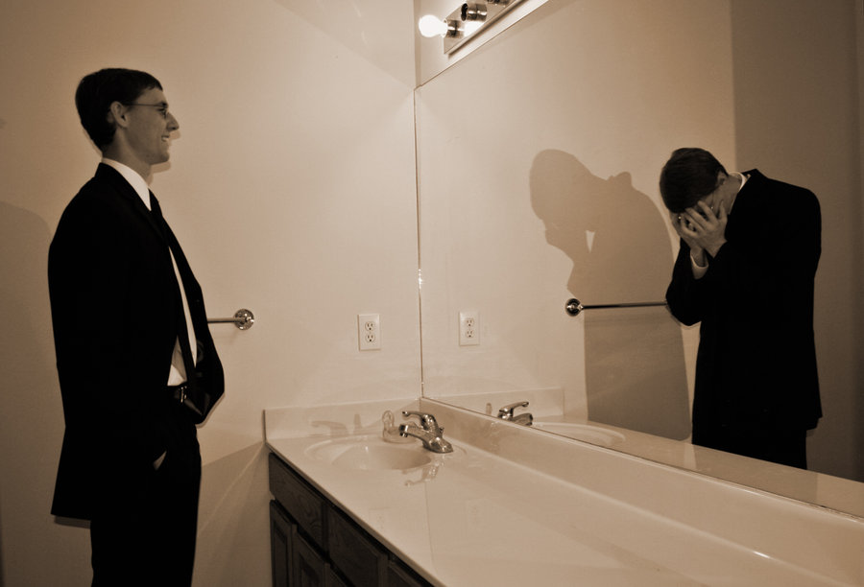
Are We Happy?
pain persists despite progress & prosperity
pursuing productivity-driven deals with death
compounds suffering & conflict
not celebrating but settling
instinctive sinfulness prefers hurting on our terms to delighting on God’s
Lutherans For Life
1 Peter 3:15-22
Life Sunday 2018
Notes:
Wait, what? Are we happy? What do you mean am I happy? We’ve gotten really prosperous and powerful. We’ve grown rather attractive and quite productive. We’re winning history. [click] Now, I suppose our workaholism hasn’t added to our joy and beauty. I guess our obsession with physical youthfulness hasn’t led to fulfillment or contentment. I’ll grant that liberating sexuality from marriage or childbearing hasn’t laid to rest guilt or grief or fear or indifference. [click] I will acknowledge that abortion on demand and embryocidal experimentation hasn’t eliminated discomfort, dysfunction, disease, or natural disasters. I admit that deals with death can’t destroy or control suffering but only transfer it or try to distract from it. [click] Actually, it’s compounding the competing and complaining we do. In many ways, it’s amplifying our abusive behaviors and chemical dependencies. As a matter of fact, it’s aggravating our anger and conflict. Truth be told, it’s intensifying isolation and multiplying evil.
[click] So no, I’m not celebrating. I’m settling. We’re all settling. We secretly sense how we do not suffice in and of ourselves. We detect deep down that we have earned the affliction and deserve it. We let go of what’s right for us to lay hands instead on what’s right before us. [click] We naturally gravitate toward what we can own rather than waiting for what we will enjoy. We instinctively accept ourselves as cheap imitations and poor replacements for the Almighty Maker. Pack and pollute our God-shaped opening until it turns into a self-inflicted injury too hidden for Him to excavate, irrigate, and occupy. Better to hurt on our own terms than to delight on His terms. If we can’t get all the credit, then we’ll take all the blame. [click]

Slide 8
Nevertheless, Hope Persists!
God doesn’t give up so easily
wrings respect even from evil and death
Christ Jesus has come and undertakes as Lord
engages failings and abides in adversities
accompanies sufferers and involves God
Lutherans For Life
1 Peter 3:15-22
Life Sunday 2018
Notes:
Nevertheless, hope persists. Hope has a thicker skin. Hope sports a stiffer spine. Christian hope has a better way, a better life, for us too, even for you. Gospel hope’s smile can stomach us and save this. We tend to underestimate God and likewise overlook hope’s hardiness. In imagining ourselves as gods, we envision Him similar to us. [click] Only God doesn’t give up so easily. He remains wonderfully steadfast, magnificently stubborn. [click] With the vigor of Father, Son, and Spirit, He pesters all our failures and our every pain with His hope, badgering tragedies and hounding wreckages, however unexpected and inescapable they appear, until He wrings respect out of evil and renders death itself gentle. Dust settles, but hope stands, because Christ Jesus is Lord.
[click] Jesus is here. He has come in the flesh, embryo and peasant, body and blood. He has suffered, physically, visibly, right alongside. He invades the world’s poverty, promiscuity, perversion. He incarnates humankind’s frauds, floods, infections. [click] He engages sinful fear and indifference. He undertakes our grief and guilt. He abides our contempt and conflict. [click] He accompanies unborn, infant, adolescent, impaired, elderly. He escorts loners, losers, and lazy ones. He involves God in our dependencies, discomforts, dysfunctions, and disasters with the presence, compassion, and power of Holy Trinity. Christ Jesus is Lord, and hope springs! [click]

Slide 9
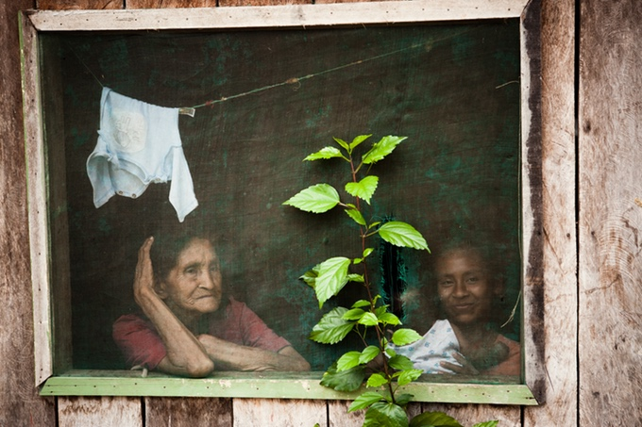
Lord Jesus Puts Hope Everywhere!
already brought forgiveness from crucifixion
takes every hardship & turns it to hope
does what’s best instead of what’s easiest
redeems people and their most awful experiences
transforms our situations into His instruments
Lutherans For Life
1 Peter 3:15-22
Life Sunday 2018
Notes:
No movement goes to waste. He presses every atom into service. He has ascended to subject all powers to His good and gracious will. [click] He who has brought us salvation from His servanthood rules the universe. He who has wrought us heaven from His homelessness orders history. He who has worked for us forgiveness from His crucifixion orchestrates each destiny. He who has reaped for us everlasting life from His execution choreographs our times and troubles. He who has derived for us resurrection from His rejection marionettes your lives and losses. [click] He who has forged for us unconditional acceptance from His ultimate abandonment takes hardship and turns it to hope. Christ Jesus is Lord, and hope grows!
[click] He does what’s best, not just what’s easiest. He makes folks get better and not just feel better. [click] He relieves His children and their despair—without requirement—so that their conditions may enjoy the confidence and conviction they’ve found. He redeems His people and their dread−−without qualification−−so that their contexts may express the encouragement and cooperation they trust. He repurposes His fellowship and our resentment—without request—in order that our episodes will wield the reason and respect we rest in. [click] He appropriates His brotherhood and our regret—without stipulation—in order that our incidents will bear the purpose and perseverance we depend upon. He consecrates His household and your aching—without restriction—for your experiences to reflect the gentleness and generosity you live by. He sanctifies His Church and your breaking—without limitation—for your existences to sparkle the enthusiasm and maturity you’re losing yourselves in. Christ Jesus is Lord, and hope yields! [click]

Slide 10
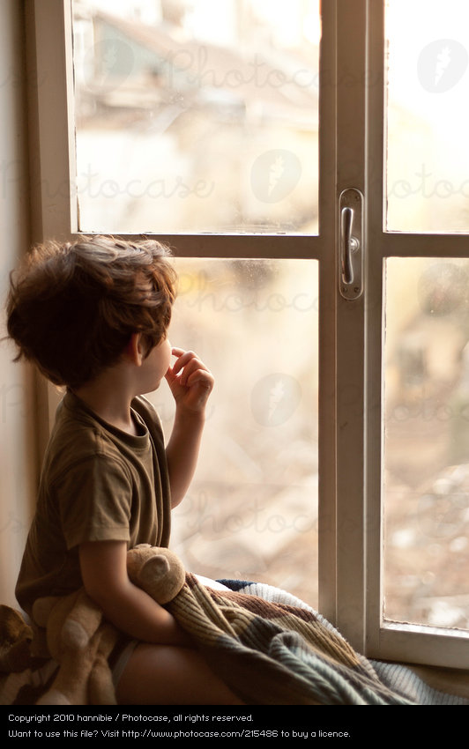
They Will Inquire About Our Hope …
unintended pregnancy? “Word became flesh!”
embryos? “God chose what is low!”
abnormalities? “power from God and not us!”
conflicted marriage? “His workmanship in His image!”
incapacitated? “He who began will bring completion!”
Lutherans For Life
1 Peter 3:15-22
Life Sunday 2018
Notes:
So they will ask. [click] Hearts will ask, “What hope is there in unintended pregnancy?” And we will answer gladly, “The Word became flesh and dwelt among us” (John 1:14), and “He bore our griefs and sorrows” (Isaiah 53:4). [click] Friends will wonder, “What hope is there in zygotes and embryos?” And we will declare readily, “God chose what is low and despised in the world so that no human being might boast” (1 Corinthians 1:28-29). [click] Relatives will inquire, “How is there hope in congenital abnormalities?” And we will proclaim cheerfully, “We have this treasure in jars of clay, to show that the surpassing power belongs to God and not to us” (2 Corinthians 4:7). [click] Neighbors will implore, “How is there hope in conflicted marriages?” And we will confess joyfully, “We are his workmanship” (Ephesians 2:10), “made in his image” (Genesis 1:27), “chosen and royal and holy” (1 Peter 2:9). [click] Acquaintances will insist, “Why is there hope for incapacitated or unresponsive cases?” And we will testify heartily, “He who began a good work in you will bring it to completion at the day of Jesus Christ” (Philippians 1:6). [click]

Slide 11
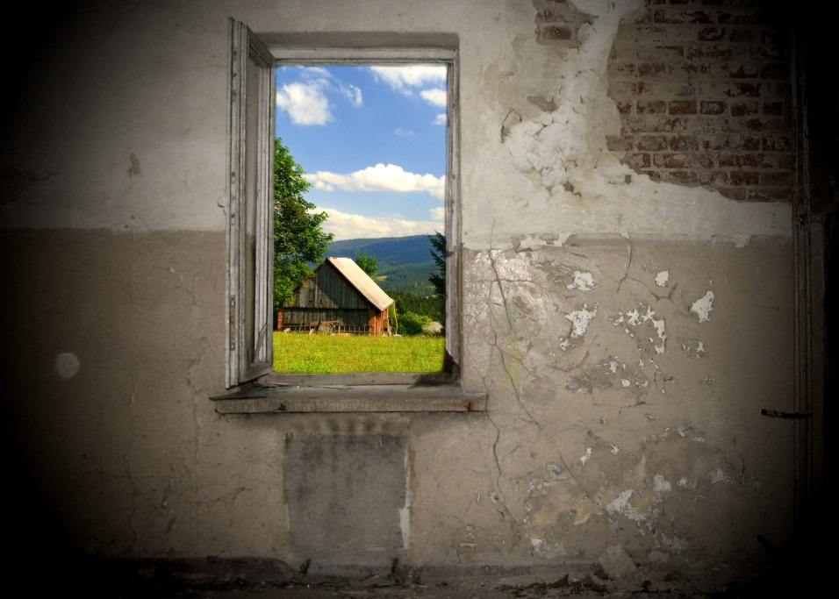
… and We’ll Include Them In It!
barrenness? “He will give us all things!”
opponents? “reconciled by God’s Son!”
chastity? “transforming our bodies like His!”
incurable? “momentary affliction, eternal glory!”
terminal? “suffering together we are the Lord’s!”
Lutherans For Life
1 Peter 3:15-22
Life Sunday 2018
Notes:
And they will ask. [click] Colleagues will demand, “Why is there hope in miscarriage and barrenness?” And we will happily verify, “He who did not spare his own Son but gave him up for us all will also with him graciously give us all things” (Romans 8:32). [click] Clients will question, “Where is the hope for abortion advocates and euthanasia enthusiasts?” And we will eagerly respond, “If while we were enemies we were reconciled to God by the death of his Son, much more shall we be saved by his life!” (Romans 5:10). [click] Critics will object, “Where is the hope in modesty and chastity?” And we will humbly assert, “He is transforming our lowly body to be like his glorious body” (Philippians 3:21). [click] Skeptics will speculate, “Can I have hope when the damage is irreversible, the condition incurable?” And we will warmly assure them, “This light momentary affliction is preparing for us an eternal weight of glory beyond all comparison” (2 Corinthians 4:17). [click] Sufferers will plead, “Can I have hope when diagnosis is terminal?” And we will affectionately promise them, “If one member suffers all suffer together” (1 Corinthians 12:26) for “whether we live or die we are the Lord’s” (Romans 14:8). [click]

Slide 12
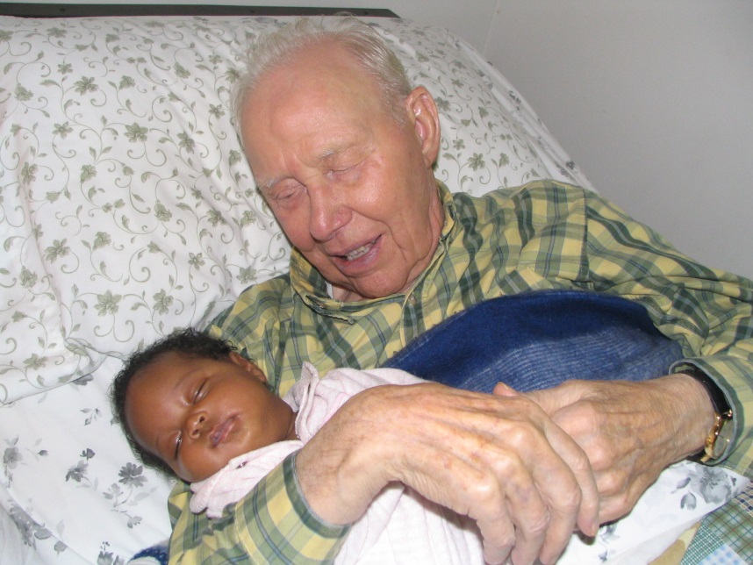
There’s Hope Even in This and For You!
Humanity even in suffering
Opportunity also in uncertainty
Promise even in weakness
Enjoyment also in unexpected
wherever there’s life, there’s God’s grace and Christ’s compassion
Lutherans For Life
1 Peter 3:15-22
Life Sunday 2018
Notes:
[click] There’s humanity even in suffering. [click] There’s still opportunity in uncertainty. [click] There’s promise even in weakness. [click] And there’s still enjoyment in the unexpected. [click] Wherever there’s life, there is God’s grace and Christ’s compassion. God never gives up, and neither do His people. There’s hope for us. There’s hope in this, for life now and the kingdom to come. There’s hope even in this, for them and for you. Amen. [click-end]

